Slide 1
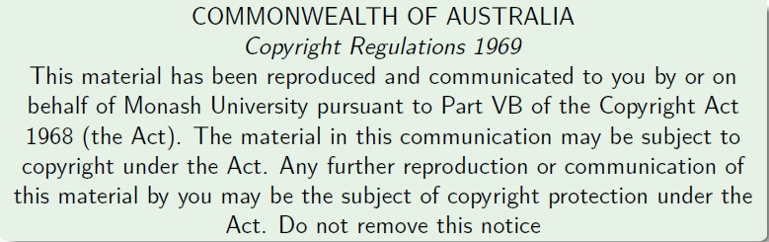
Faculty of Information Technology, Monash University

Slide 2
FIT2004, S2/2016
Week 1: Introduction and Abstract Data Types
Lecturer: Muhammad Aamir Cheema
acknowledgmentS
The slides are based on the material developed by Arun Konagurthu and Lloyd Allison.

Slide 3
Outline
Part 1: Introduction to the unit
Part 2: Abstract Data Types (ADTs)

Slide 4
What’s this unit about
The subject is about problem-solving with computers: algorithms and data structures.
The subject is not (mainly) about programming.
The subject just happens to use Python as the programming language in which lab work (etc.) is done. This subject is really language agnostic.
Algorithms in this courseware will be presented/describe in English, pseudo-code, procedural set of instructions, Python, or even other programming language(s), as convenient.

Slide 5
Why take this unit very seriously?
The subject is arguably the most important for computer and technology related careers
Big companies (e.g., Google, Microsoft, Facebook etc.) actively hunt for people good at algorithms and data structures
The things you learn will help you throughout your career
Expertise in algorithms and data structures is a must if you want to do research in computer science
This unit is CHALLENGING
You have to be on top of it from week 1 – you cannot pass if you think I can cover up the material close to the assessment deadlines
Missing lectures, labs or tutorials will require double the efforts to recover
Good News: If you are willing to learn, you will enjoy this unit
FIT2004 Programming Competition: a fun way to learn

Slide 6
Overview of the content
The unit aims to cover
General problem-solving strategies and techniques, e.g.
Useful paradigms, e.g.
dynamic programming,
divide and conquer, etc.
Analysis of algorithms and data structures, e.g.
abstract data types,
program proof / correctness
analysis and estimation of space and time complexity, etc.
A selection of important computational problems, e.g.
sorting,
retrieval/searching, etc.
A selection of important algorithms and data structures,
as a tool kit for the working programmer,
as example solutions to problems
as examples of solved problems, to gain insight into concepts

Slide 7
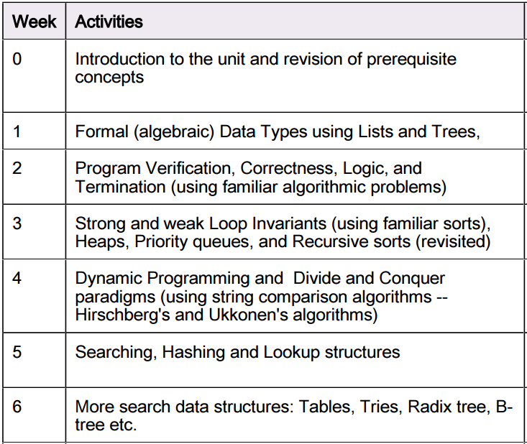
Overview of the content

Slide 8
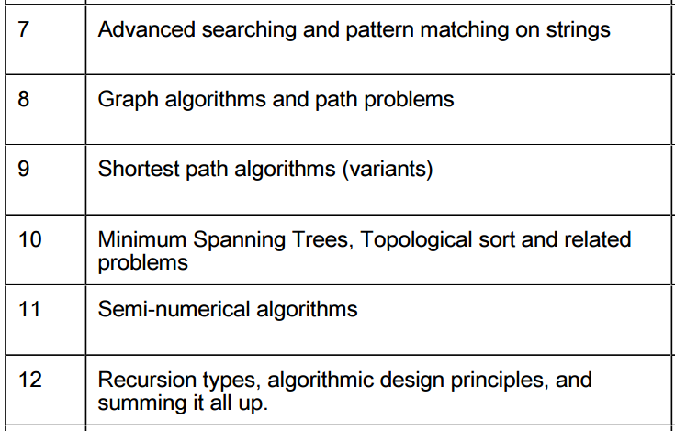
Overview of the content

Slide 9
FIT2004 Staff
Chief Examiner:
Dr. Arun Konagurthu, arun.konagurthu@monash.edu
Office: 25 Exhibition Walk, Room 229
webpage: http://www.csse.monash.edu.au/~karun
Lecturer:
Dr. Muhammad Aamir Cheema, aamir.cheema@monash.edu
Office: 25 Exhibition Walk, Room 113
webpage: www.aamircheema.com
Tutors:
Ammar Sohail, ammar.sohail@monash.edu
Chaluka Salgado, chaluka.salgado@monash.edu
Han Duy Phan, han.phan@monash.edu
Leon Zhu, liguang.zhu@monash.edu

Slide 10
Course Material
Your main portal will be, as you already know, the unit's Moodle page: http://moodle.vle.monash.edu/
Material available on Moodle will include:
Introductory Notes
Lecture slides
Additional references
Practical (Lab) sheets
Tutorial sheets
Remember(!) to subscribe to forums and set your e-mail forward

Slide 11
Online reading and research material
This courseware is built directly on material developed during the previous avatar of FIT2004 (between 1999-2006, when it was called CSE2304). This following link contains a treasure trove of source material on this unit that we will rely on this semester: http://www.csse.monash.edu.au/courseware/cse2304/2006/
It is highly recommended that all students navigate through this online material, in addition to the lecture slides on Moodle.
Following this material, will widen the boundaries of your learning on this topic.
Especially, there are a number of Javascript-based interactive research material explaining various Algorithms and Data Structures at this link: http://www.csse.monash.edu.au/~lloyd/tildeAlgDS.They are fun and pretty insightful to play around with.

Slide 12
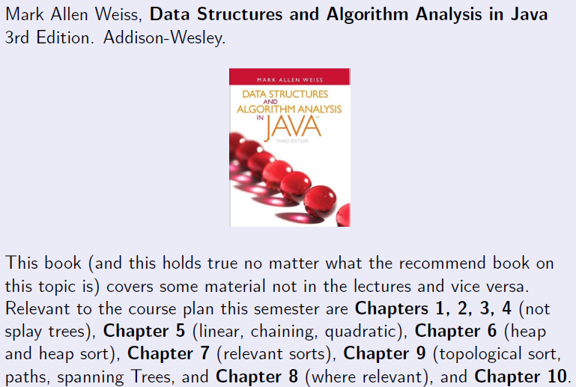
Textbook reference

Slide 13
(Highly) recommended readings
This subject has immense practical value for your development into professional programmers, technicians, software engineers, computer scientists, etc. Therefore, you should read beyond what is prescribed for this unit.
Additional books you might want to refer to (from time-to-time, even beyond this unit):
Thomas H. Cormen, Charles E. Leiserson, Ronald L. Rivest, Cliord Stein. Introduction to Algorithms. 3rd Edition. The MIT Press & Mc Graw Hill.
Donald Knuth, The Art of Computer Programming, Pearson. (Pretty expensive, but good-value-for-money for serious programmers; library has copies!)

Slide 14
Course Structure
Lectures
Mondays 17:00 to 19:00 @CL_21Rnf/S7
Practicals/Pracs/Labs (refer to your timetable in allocate+)
Every week, starting week 2
Pracs in weeks 2, 3, 5, 7, 9, 11 are NOT assessed and conducted over a 2 hour slot (except the ‘practice’ lab in wk 2 which will go on for the full 3 hrs).
Pracs in weeks 4, 6, 8, 10, 12 are ASSESSED and conducted over a 3 = 1.5 + 1.5 hour slot (where the last 1.5 hour is used for marking/assessment).
Tutorials/Tutes (refer to your timetable in allocate+):
1 hour fortnightly, starting week 3.
Weeks 3, 5, 7, 9, 11
This 1 hour slot will immediately precede non-assessed pracs in weeks 3, 5, 7, 9, 11

Slide 15
Tutorials (in more details)
1 hour fortnightly, compulsory
Weeks 3,5,7,9,11
Locations and times (see Allocate+)
Notes are made available during semester and may be downloadable from Moodle
Tutorials must be attempted during self-study beforehand
Tutorials provide, among other things, background to pracs, especially those that are assessed.

Slide 16
Pracs (in more details)
Held weekly starting week 2, all the way through to week 12.
Locations and times see Allocate+.
3 hour Assessed lab in Weeks 4, 6, 8, 10 and 12. The last 1-1.5 hour during these weeks will be used for marking.
Conducted by your Tutors
Organize your computer account before the first prac in week 2, if you don't already have one.
Important: All programming questions in your lab have to be done in Python programming language.

Slide 17
Marks and hurdles - IMPORTANT
To pass FIT2004
Your marks must average to at least 50% of the total marks for this unit, and
you must pass each of the hurdles
Prac class assessments = 30% of total semester marks
Total in-semester marks =30 out of 100, with 6 marks per assessed prac in weeks 4,6,8,10,12 .
HURDLE: You should score at least 40% of the in-semester marks (i.e., 12 out of 30 marks)
End-of-Semester Examination = 70% of total semester marks
End-of-Semester (written) exam carries 70 marks.
HURDLE: You should score at least 40% of the exam marks (i.e., 35 out of 70 marks)

Slide 18
Missed Prac
If you miss an assessed prac, you will be marked as ABSENT, unless you do TWO things:
Arrange to attend an alternative prac the same week (with the approval of the Lecturer and Tutor), AND
Email to your Lecturer and Tutor, the following details
Name:
Student ID number:
Date of replacement Prac:
Time and Location of the regular prac:
Time and Location of the replacement prac:
NOTE: The subject line of your email should read
FIT2004: Replacement lab request for <your student number>

Slide 19
Missed Prac
If you are unable to attend a replacement prac due to an illness or emergency, then
Obtain supporting documentation (e.g., medical certificate)
Fill out a Special Consideration Form and hand it in (with supporting documentation) to me (Office 113, CL 25Exhibition; slide it under my door if I am not in).
Read Monash University's [Special Consideration policy].

Slide 20
Plagiarism and Cheating
Monash University takes plagiarism and cheating very seriously. There
are severe penalties for them.
Read Monash University's [Plagiarism and cheating Policy]
In a nutshell, Plagiarism is legitimately using someone else's work, but not acknowledging it. Cheating is pretending that someone else's work is your own, in order to gain an unfair advantage.
It is OKAY to work together in trying to understand concepts. Peer Assisted learning (PAL) is fun and a great way to cross-fertilize each others' thinking -- but each student must be conscientious in his work, write the entire assignments alone, and be able to explain and modify it on request

Slide 21
Student responsibilities
Responsibilities
Be regular to the weekly lecture.
Catch up missed lectures promptly through recordings on MULO.
Attendance to labs and tutes are compulsory
Do not leave the assessed lab before your lab demonstrator has marked your assignment.
Prepare during self-study (nominally 8 hours/week -- more is better).
This subject is best understood practically. So, assimilating various concepts and practicing them (a lot!) is the key to success here.
Etiquette
No noise and distractions during the lectures
Turn your mobile devices to silent mode.

Slide 22
FIT2004: Programming Competition
Contest Format
Individual contest requiring you to write program to solve algorithmic problems
Three rounds. Tentative schedule:
Round 1: Week 3
Round 2: Week 7
Round 3: Week 11
3-6 problems in each round; each round will accept submissions for 1-2 weeks
Solutions will be automatically marked by an online judging system
Your score is the number of problems you solve
Contestants will be ranked according to their scores, and ties will be broken based on penalty (explained below)
Each incorrect submission carries a penalty. But the penalty is only applied if you finally solve the problem (e.g., say you solve problem #1 in 3 attempts and you have 3 failed attempts for problem #2 which you were unable to solve. Your score will be 1 and penalty will be 2 failed attempts on problem #1.)
Registration: to be open soon (keep an eye on Moodle)
Prizes: TBA + (Certificates for top-5 contestants)
Practice: www.codeforces.com, https://uva.onlinejudge.org/

Slide 23
MARS: Monash Audience Response System
Visit http://mars.mu on your internet enabled device
Log in using your Authcate details (not required if you’re already logged in to Monash)
Touch the + symbol
Enter the code for your unit: Y4R44G
Answer questions when they pop up

Slide 24
MARS: Multiple Choice Questions
1 + 1 = ?
2
10
Not sure
Hint: There are 10 types of people in this world. Those who understand Binary and those who don’t.

Slide 25
MARS: Text-based questions
Where do you live? (write the name of the suburb)

Slide 26
Anonymous surveys
Throughout the semester, I will send a few anonymous surveys to get your feedback on things that can be improved in this unit
Please do fill these surveys (will take < 5 mins)

Slide 27

Short break

Slide 28
Part 2: Abstract Data Types
Thinking about Abstract data types (ADTs) algebraically and formally.
Algebraic data type: [List]
Algebraic data type: [(Binary) Tree]
Reasoning about algorithms on such ADTs formally
Reminder
Subject is about problem solving...
...and not programming (in Python) as such.

Slide 29
What and Why ADTs?
An Abstract Data Type provides a mathematical model to define a data type and its possible values, operations and behavior.
Definition
Operations
Rules
Functions
Advantages
It is much easier to reason formally about ADTs and abstract algorithms than about structures in algorithms in some specific language
Abstraction guarantees that any implementation of an ADT guarantees certain properties and abilities

Slide 30
List ADT: Definition
TYPES
type list e = nil | cons(e * (list e))
In plain English:
A list of elements of type e is (=) either empty (nil) or (|) is constructed (cons) using an element of type e AND (*) a list.
L
is
or
nil
e
is
or
e
nil
e
e
is
or …

Slide 31
List ADT: Operations
Operations
isNull : list e -> boolean ;OR: isEmpty, null etc.
head : list e -> e ;OR: hd, first , etc.
tail : list e -> list e ;OR: tl, rest , etc.
cons : e * (list e) -> list e
L
T
h

Slide 32
List ADT: Rules
RULES
isNull(nil) = true
isNull(cons(h,T)) = false
head(cons(h,T)) = h
head(nil) = error
tail(cons(h,T)) = T
tail(nil) = error
EXAMPLES:
isNull(L1) = true
isNull(L2) = false
head(L2) = h
head(L1) = error
tail(L2) = T
tail(L1) = error
L1
nil
L2
T
h

Slide 33
List ADT: Functions
length function
length(nil) = 0
| length(cons(h,T)) = 1 + length(T)
Observations
the length function has been recursively defined here
While there are (potentially) infinitely many lists, there are only two cases that the length function must consider.
Note, most functions on lists have the same general structure as length. If one case is missing the function is probably INCOMPLETE!
L1
nil
EXAMPLES:
length(L1) = 0
length(L2) = 1 + length(T)
L2
T
h

Slide 34
List ADT: Functions
Append function
append(nil, L2) = L2
| append(L1,L2) = append(cons(h1,T1),L2)
= cons(h1,append(T1,L2))
;COMMENT: L1, L2 are two lists. h1 = head(L1). T1 = tail(L1).
L1
3
4
nil
L2
1
6
7
nil
append(L1,L2)
3
4
1
6
7
nil

Slide 35
List ADT: Functions
Append function
append(nil, L2) = L2
| append(L1,L2) = append(cons(h1,T1),L2)
= cons(h1,append(T1,L2))
L1
3
4
nil
L2
1
6
7
nil
cons(3,append(T1,L2))
+(
,
)
3
4
nil
1
6
7
nil
h1
T1
L2
cons(3, cons(4,append(tail(T1),L2))
+ (
+ (
,
))
3
4
nil
1
6
7
nil
h1
head(T1)
tail(T1)
L2
cons(3, cons(4,append(nil,L2))
3
4
1
6
7
nil

Slide 36
List ADT: Functions
Append function
append(nil, L2) = L2
| append(L1,L2) = append(cons(h1,T1),L2)
= cons(h1,append(T1,L2))
What is the time complexity of the append function?
O(|L1|)
O(|L2|)
O(|L1| + |L2|)
O(|L1| X |L2|)
None of the above
Note: |L| is the number of elements in a list
IMPORTANT: Some implementations offer better complexity. ADT defines what a function does not how it is done.

Slide 37
Proofs with ADTs
Theorem
The append operation is associative:
append(L1,(append(L2,L3))) = append(append(L1,L2),L3)
Prove it by induction ???

Slide 38
Revision: Proof by induction
2 steps
Prove the base case, e.g., for the first state
Assume the proof holds for a state k. Show that it also holds for the next state k+1.
Theorem
Let S(N) be the sum of the integers from 1 to N
Prove that S(N) = N(N+1)/2
Step 1: Base Case: N = 1
S(1) = 1 and N(N+1)/2 is 1 for N=1
Step 2: Inductive step
Assume it holds for a positive integer k
S(k) = k(k+1)/2
Show that S(k+1) = (k+1)(k+2)/2
continued on next slide…

Slide 39
Revision: Proof by induction
Theorem
Let S(N) be the sum of the integers from 1 to N
Prove that S(N) = N(N+1)/2
Step 2: Inductive step
Assume it holds for a positive integer k
S(k) = k(k+1)/2
Show that S(k+1) = (k+1)(k+2)/2
S(k+1) = 1 + 2 + 3 + … + k+1
S(k+1) = 1 + 2 + 3 + … + k + k+1
S(k+1) = k(k+1)/2 + k+1
S(k+1) = (k+1)(k+2)/2
For more details, watch it on Khan Academy (click here)

Slide 40
Proof: Append is associative
Theorem
The append operation is associative:
append(L1,(append(L2,L3))) = append(append(L1,L2),L3)
Step 1: Base Case (L1 is nil)
append(nil ,(append(L2,L3)))
= append(L2,L3)
= append(append(nil,L2),L3)
Step 2: Inductive step
Suppose L1 is cons(h1,T1). Assume that the proof holds for the state T1, e.g.,
append(T1,(append(L2,L3))) = append(append(T1,L2),L3)
Show that it holds for the next state where the next state is when the list L1 is cons(h1,T1)
continued on next slide …

Slide 41
Proof: Append is associative
Theorem
append(L1,(append(L2,L3))) = append(append(L1,L2),L3)
Step 2: Inductive step
Assume that the proof holds for the state T1, e.g.,
append(T1,(append(L2,L3))) = append(append(T1,L2),L3)
Show that it holds for the next state where the next state is when the list L1 is cons(h1,T1)
append(L1,append(L2,L3))
= append(cons(h1,T1), append(L2,L3))
= cons(h1,append(T1,append(L2,L3)))
;COMMENT: use the assumption
= cons(h1, append(append(T1,L2),L3))
= append(cons(h1,append(T1,L2)), L3)
= append(append(cons(h1,T1),L2), L3)
= append(append(L1,L2), L3)

Slide 42
List ADT: Functions
merge function;produces a sorted list if L1&L2 are sorted
;COMMENT: when at least one list is null
merge(nil, nil) = nil
| merge(nil, L1) = L1
| merge(L1, nil) = L1
; COMMENT: when L1 not null and L2 not null
| merge(L1, L2) =
if head(L1) < head(L2) then
cons(head(L1), merge(tail(L1),L2))
else ;if head(L1) >= head(L2)
cons(head(L2), merge(L1, tail(L2)))
L1
1
6
nil
L2
3
4
5
nil
merge(L1,L2)
1
3
4
5
6
nil

Slide 43
List ADT: Functions
reverse function
reverse(nil) = nil
| reverse(cons(h,T)) = append(reverse(T),cons(h,nil))
L1
3
4
5
nil
reverse(L1)
5
4
3
nil

Slide 44
List ADT: Functions
reverse function
reverse(nil) = nil
| reverse(cons(h,T)) = append(reverse(T),cons(h,nil))
L1
3
4
5
nil
append(reverse(T1),cons(h1,nil))
+
4
5
nil
3
nil
append(append(reverse(tail(T1),cons(head(T1),nil))
,cons(h1,nil))
((
+
) +
)
5
nil
4
nil
3
nil
.
.
.
5
4
3
nil

Slide 45
List ADT: Functions
reverse function
reverse(nil) = nil
| reverse(cons(h,T)) = append(reverse(T),cons(h,nil))
What is the time complexity of reverse function?
O(N)
O(N²)
O(N log N)
None of the above
Note: N is the number of elements in the list

Slide 46
Comments on recursion and iterations
Many of the operations on lists (and other recursive data types) are naturally expressed as recursive routines.
Recursive routines have fewer state variables than iterative routines and are frequently easier to prove correctness. However recursion does require system-stack space to operate.
Iterative versions of many routines, particularly for the simpler operations, are straightforward to implement so often preferred, but are much harder to prove correctness.
We are not going to discuss merits and demerits of recursion now. Suffice it to say that recursion and iteration are both powerful and useful techniques.

Slide 47
Implementing Lists
The most natural way to implement lists is by means of records/structs and pointers/links.
They can also be implemented using arrays.
You (might) have done this exercise in FIT1008.
In any case, we will implement this as an exercise, to warm up your programming abilities.

Slide 48
The Abstract Data Type: Trees
Trees are natural structures for representing certain kinds of hierarchical data.
A (rooted) tree consists of a set of nodes (or vertices) and a set of arcs (or edges).
Each arc links a parent node to one of its children.
A special root node has no parent.
Every other node has exactly one parent.
It is possible to reach any node by following a unique path of arcs from the root.
If arcs are considered bidirectional, there is a unique path between any two nodes.
The simplest kind of tree is a binary tree where each parent has at most two children.

Slide 49
ADT Trees: Definition
TYPES:
type tree e = nilTree | fork e * (tree e) * (tree e)
T
is
nil
or
e

Slide 50
ADT Trees: Operations
empty: tree e -> boolean
leaf : tree e -> boolean
fork : e * tree e * tree e -> tree e
left : tree e -> tree e
right: tree e -> tree e
contents: tree e -> e
5
4
6
2
3
nil
nil
nil
nil
nil
nil

Slide 51
ADT Trees: Functions
height function
height(nilTree) = 0
| height(fork(e,TL,TR)) = 1+max(height(TL), height(TR))
5
4
6
2
3
nil
nil
nil
nil
nil
nil
What is the height of the above tree?

Slide 52
ADT Trees: Functions
weight function
weight(nilTree) = 0
| weight(fork(e,TL,TR)) = 1+weight(TL)+weight(TR)
5
4
6
2
3
nil
nil
nil
nil
nil
nil
What is the weight of the above tree?

Slide 53
Recursive traversal of trees
There are three classic ways of recursively traversing a tree or of visiting every one of its nodes once.
In each of these, the left and right subtrees are visited recursively
The distinguishing feature is when the element in the root is visited or processed.

Slide 54
Preorder or prefix traversal
In a preorder or prefix traversal the root is visited first (pre) and then the left and right subtrees are traversed.
preorder(nilTree) = nil
| preorder(fork(e,TL,TR)) = print(e),preorder(TL),preorder(TR)
5
4
6
What is the preorder:
23456
54236
54623
24356
None of the above
2
3
nil
nil
nil
nil
nil
nil

Slide 55
Inorder or Infix traversal
In an inorder or infix traversal, the left sub-tree is traversed then the root is visited and then the right sub-tree
inorder(nilTree) = nil
| inorder(fork(e,TL,TR)) = inorder(TL),print(e),inorder(TR)
5
4
6
What is the inorder:
23456
54236
54623
24356
None of the above
2
3
nil
nil
nil
nil
nil
nil

Slide 56
Postorder or postfix traversal
In a postorder or postfix traversal, the left and right sub-trees are traversed then the root is visited
postorder(nilTree) = nil
| postorder(fork(e,TL,TR))= postorder(TL),postorder(TR),print(e)
5
4
6
What is the inorder:
23456
54236
54623
24356
None of the above
2
3
nil
nil
nil
nil
nil
nil

Slide 57
Breadth-first traversal
In a breadth-first traversal, root is visited then its children and then its grandchildren and so on. It is naturally an iterative traversal, hence, its recursive version is not given here.
5
4
6
2
3
nil
nil
nil
nil
nil
nil
One possible breadth-first order of the tree is 54623

Slide 58
Concluding Remarks
Take home message
This unit demands your efforts from week 1
ADTs provide flexibility and ease of proofs
A proof is much stronger than a test
Things to do (this list is not exhaustive)
Read more about content covered in this lecture
If you do not understand computational complexity, study to develop some background (e.g., watch videos, read other online resources)
Coming Up Next
Correctness, verification and analysis of algorithms
Loop invariances, simple sorting and complexity issues

